Slide 1
Global Sales Performance Dashboard - Summary
Objective: Design an interactive dashboard for business stakeholders.
• Tool Used: Power BI
• Dataset: Cleaned global sales data
• Purpose: Track sales KPIs, trends, top customers, and regional performance.
• Outcome: Helps in making data-driven decisions using visual insights.

Slide 2
Dashboard Highlights
Key Features:
• KPI Cards: Total Sales, Total Orders, Avg Sales per Order
• Time-Series Analysis: Sales trend over time
• Top Customers & City-wise Sales
• Sales by Territory (Pie Chart)
• Interactive Filters: Year, Country, City
• Consistent dark theme for better visibility

Slide 3
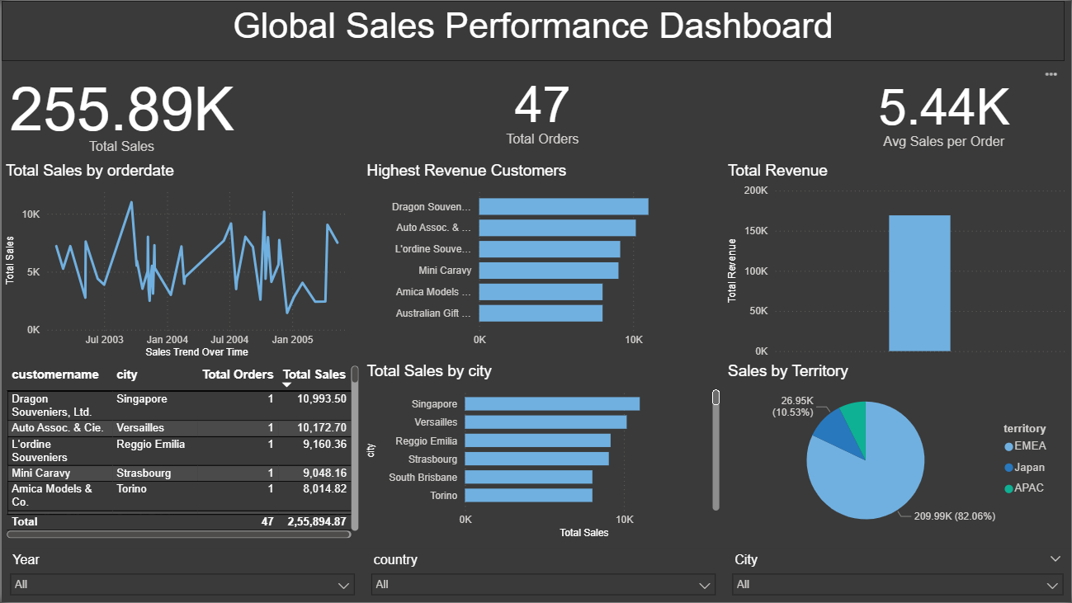
Dashboard Overview

